Slide 1
Object detection on Dental Images

Slide 2
Index
Definition
Dataset Information
Image Annotations
Image Enhancing
a)Histogram Enhancing
b)Adaptive Histogram Enhancing
Working of object detection Models.

Slide 3
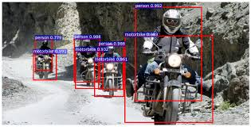
Object Detection
Object detection is process in computer vision
which classify as well as trace location of more than one objects present in an image

Slide 4
Dataset Information
The dataset contain dental full mouth x-ray images.
Average width of images : 1000px
Average height of images : 538px
Total number of images in dataset: 60
Number of training images: 40
Number of validation images: 10
Number of test images: 10

Slide 5
Image Annotation
Image annotation is process of data preparation which involves drawing bounding box around image as well as assigning class label which helps algorithm in learning process.

Slide 6
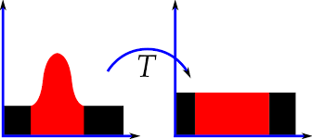
Image Enhancing
Histogram Equalization

Slide 7
Adaptive Histogram Equalization

Slide 8
Working
How to frame target
How to calculate Error
Sliding Window approach
Region Proposal
Inter-section Over union
Non-max suppression
Single Shot learning

